Slide 1
Probability & Statistics
Rijah Khan
Cyber Security

Slide 2
Chapter 2
Presentation of Data
(Graphs)

Slide 3
Graphical Presentation
Graphical presentation of frequency distributions facilitate easy understanding of data presentation and interpretation.
The shape of the graph gives an exact idea of the variations of the distribution trends.
Categorical Data
Quantitative Data

Slide 4
Categorical Data- Graphs
Categorical data charts are used to represent and visualize data that falls into distinct categories or groups.
Here are some common types of charts for presenting categorical data:
Bar Charts
Pie Chart or Circle Diagram

Slide 5
Bar Charts
Summarizes categorical data.
Horizontal axis represents categories, while vertical axis represents either counts (“frequencies”) or percentages (“relative frequencies”).
Used to illustrate the differences in percentages (or counts) between categories.

Slide 6
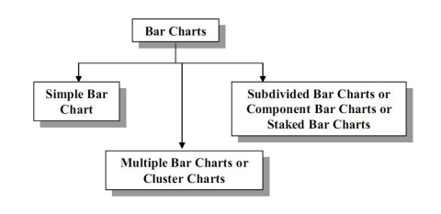
Bar Charts
There are three types of Bar Charts which are:
Simple Bar Chart
Multiple Bar Chart or Cluster Chart
Component Bar Chart or Subdivided Bar Chart or Staked Bar Chart

Slide 7
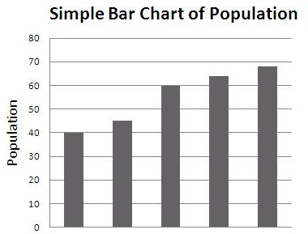
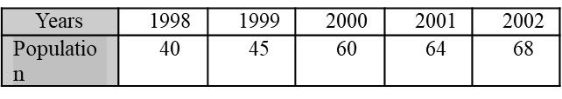
Simple Bar Chart
This chart consists of vertical or horizontal bars of equal width. The length of the bars represents the magnitude of the values of the variable i.e. the lengths of the bars vary depending on the size of data values.
The following table gives the population of Punjab. Draw a Simple Bar Chart.
1998 1999 2000 2001 2002

Slide 8
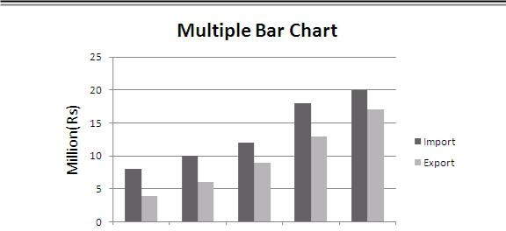
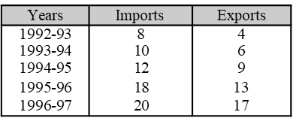
Multiple Bar Chart
By Multiple Bar Charts two or more sets of inter-related data are represented. The technique of Simple Bar Chart is used to draw this chart but the difference is that we use different shades, colors or dots to distinguish between different phenomena. Multiple Bar Charts facilities comparison between more than one phenomenon.
The following table gives the imports and exports of Pakistan for year 1992-93
to 1996-97. Draw a Multiple Bar Chart.
1992-93
1993-94
1994-95 1995-96
1996-97

Slide 9
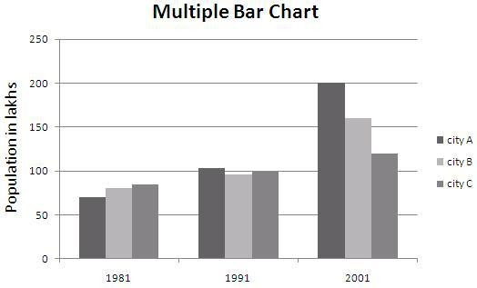
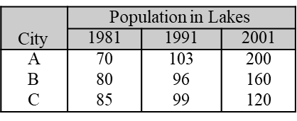
Multiple Bar Chart
Construct a Multiple Bar Chart to show the population of the cities given in the following table:

Slide 10
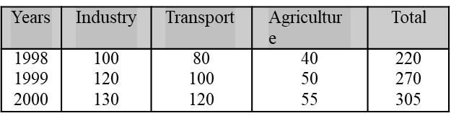
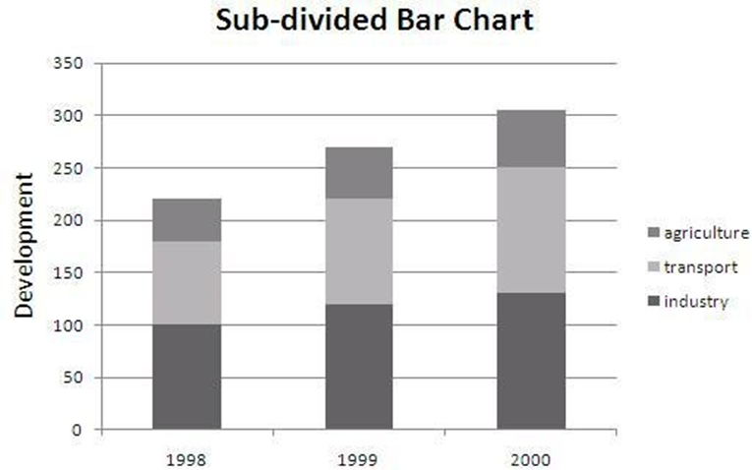
Component Bar Chart
A Component Bar Chart is an effective technique in which each bar is sub-divided into two or more parts. The component parts are shaded or colored differently to increase the overall effectiveness of the diagram.
The following table represents the yearly development in the filed of industry, transport and agriculture of Pakistan. Construct a Sub-divided Bar Chart:

Slide 11
Pie Chart
A Pie-Diagram, also known as Sector or Circle Diagram, is a chart consisting of a circle divided into sectors or pie-shaped pieces whose areas are proportional to the various parts into which the whole quantity is divided. The sectors are shaded or colored differently. The procedure of constructing a pie chart is very simple; draw a circle of some suitable radius. As a circle consists of 360⁰, the whole quantity to be displayed is equated to 360. Then divide the circle into different sectors by constructing angles at the center by means of a protractor and draw the corresponding radii.
The angles are calculated by the following formula:
_{Angle =} Component Part _{× 3600}
Whole Quantity

Slide 12
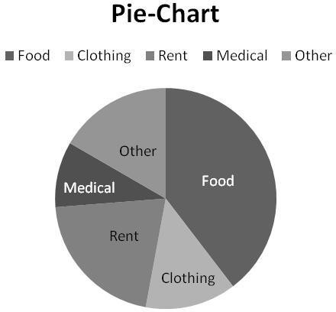
Draw a Pie-diagram for the following data:
Items |  | Expenditure in Rs.
Food | 190
Clothing | 64
Rent | 100
Medical | 46
Other | 80
To construct Pie-diagram; first we find Angles and cumulative Angles as given below:
Items |  | Expenditure in Rs. |  | Angles | Cum: Angles
Food | 190 |  |  | 142.5 | 142.5
Clothing | 64 |  |  | 48 | 190.5
Rent | 100 |  |  | 75 | 265.5
Medical | 46 |  |  | 34.5 | 300
Other | 80 |  |  | 60 | 360
Total | 480 |  |  | 360 | --

Slide 13
Quantitative Data- Graphs
Quantitative data charts are used to represent and visualize numerical data, allowing you to analyze and convey information related to quantities, values, and measurements.
Here are some common types of charts for presenting quantitative data:
Histogram
Frequency Polygon
Cumulative Frequency Polygon(Ogive)

Slide 14
Histogram
A histogram consists of a set of rectangles having bases on a horizontal axis
i.e. X-axis (note that these bases are marked off by class boundaries not class
limits) with centers at the class marks and areas proportional to the class
frequencies.
If the class intervals sizes are equal then the heights of the rectangles are also
proportional to the class frequencies and are taken numerically equal to class
frequencies.
If the class intervals sizes are not equal then the heights of the rectangles have
to be adjusted.

Slide 15
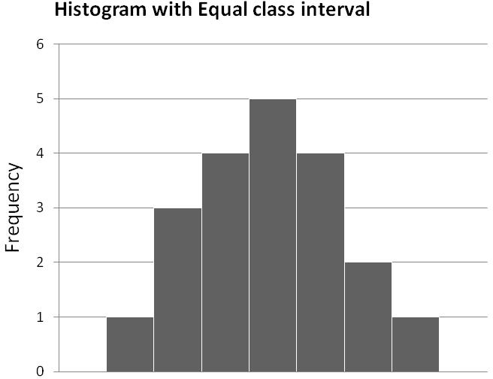
Equal Class Interval
To draw a Histogram we proceed with the following steps:
Find class-boundaries.
 | Class Limits |  |  |  | 40-49 | 50-59 | 60-69 | 70-79 | 80-89 | 90-99 | 100-109
 |  | Frequency |  |  | 1 | 3 | 4 | 5 | 4 | 2 | 1
Mark class-boundaries along the x-axis and the frequencies along y-axis.
Construct rectangles having width proportional to class-interval size and
heights proportional to class frequencies.
Class Limits |  | Frequency |  | Class-boundaries
40-49 | 1 |  |  | 39.5-49.5
50-59 | 3 |  |  | 49.5-59.5
60-69 | 4 |  |  | 59.5-69.5
70-79 | 5 |  |  | 69.5-79.5
80-89 | 4 |  |  | 79.5-89.5
90-99 | 2 |  |  | 89.5-99.5
100-109 | 1 |  |  | 99.5-109.5
39.5
49.5
59.5
69.5
79.5
89.5
99.5
109.5

Slide 16
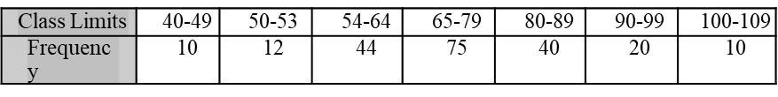
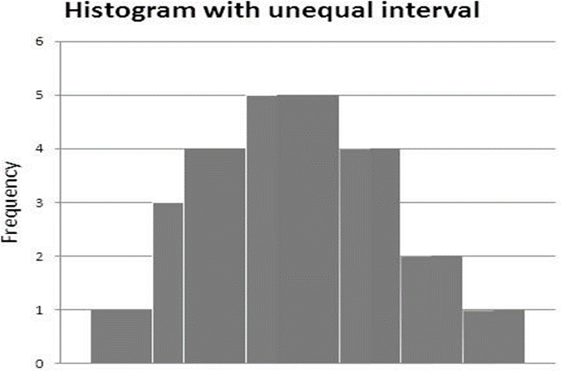
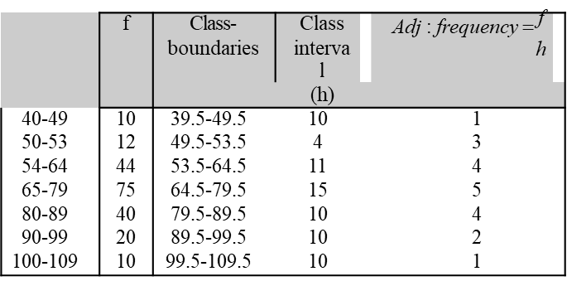
Unequal Class Interval
To draw a Histogram we proceed with the following steps:
Find class-boundaries and adjusted frequencies.
Construct Histogram from the following frequency distribution
Mark class-boundaries along the x-axis and the adjusted frequencies along y-axis.
Construct rectangles having width proportional to class-interval
size and heights proportional to class adjusted frequencies.
39.5
53.5
49.5
64.5
79.5
89.5
99.5
109.5

Slide 17
Frequency Polygon
A frequency polygon is a many sided closed figure.
It is constructed by plotting the class frequencies against their corresponding class marks (mid-points) and then joining the resulting points by means of straight lines.
It can also be obtained by joining the mid-points of the tops of rectangles in the histograms.

Slide 18
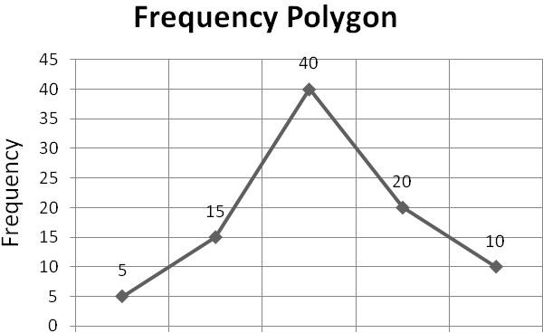
.
Construct Frequency Polygon from the following frequency distribution:
To draw a Frequency Polygon we proceed with the following steps:
Find class-marks (mid-points).
 | Class Limits |  |  |  | 10-19 | 20-29 | 30-39 | 40-49 | 50-59
 |  | Frequency |  |  | 5 | 15 | 40 | 20 | 10
Mark mid-points along the x-axis and the frequencies along y-axis.
Place a dot against each mid-point with respect to its class frequency.
Class Limits |  | Frequency |  | Mid-points
10-19 | 5 |  |  | 14.5
20-29 | 15 |  |  | 24.5
30-39 | 40 |  |  | 34.5
40-49 | 20 |  |  | 44.5
50-59 | 10 |  |  | 54.5
14.5
24.5
34.5
44.5
54.5

Slide 19
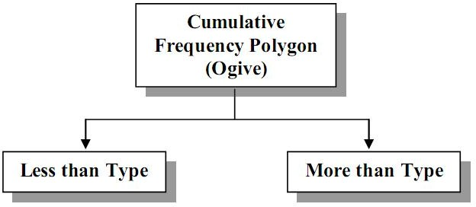
Cumulative Frequency Polygon(Ogive)
When a curve is based on cumulative frequencies then it is called a
cumulative frequency polygon or ogive.
Less Than Type
More Than Type

Slide 20
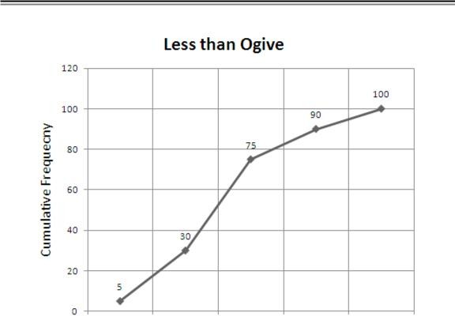
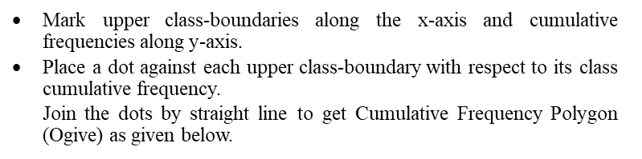
Less Than Type Method
Construct Cumulative Frequency Polygon (Ogive)
from the following frequency distribution:
Class Limits |  |  | 10-19 | 20-29 | 30-39 | 40-49 | 50-59
Frequency |  |  | 5 | 25 | 45 | 15 | 1
To draw a Cumulative Frequency Polygon (Ogive) we proceed with the following steps:
Find class-boundaries and cumulative frequencies.
Class Limits |  |  |  | Cumulative |  | Class-boundaries
 |  | Frequency |  | Frequency
10-19 | 5 |  |  | 5 |  | 9.5-19.5
20-29 | 25 |  |  | 30 |  | 19.5-29.5
30-39 | 45 |  |  | 75 |  | 29.5-39.5
40-49 | 15 |  |  | 90 |  | 39.5-49.5
50-59 | 1 |  |  | 100 |  | 49.5-59.5
19.5
29.5
39.5
49.5
59.5

Slide 21
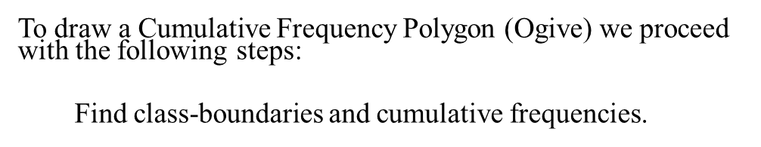
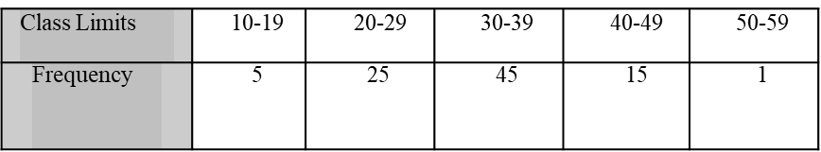
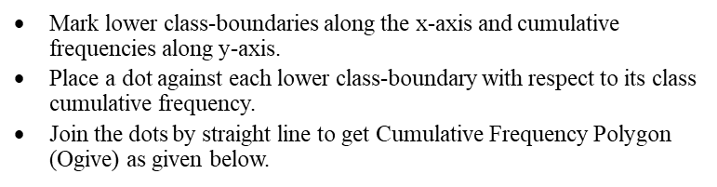
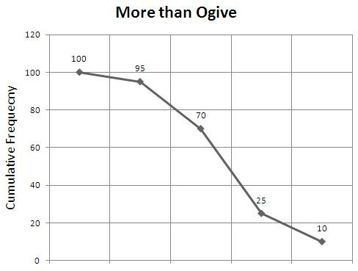
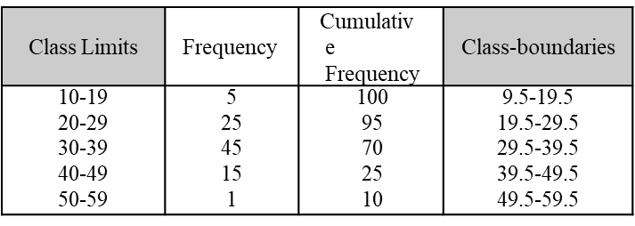
More Than Type Method
9.5
19.5
29.5
39.5
49.5

Slide 22
Shapes of the Distributions
Normal Distribution (Bell Curve)
Symmetrical with a peak at the mean.
Skewed Right Distribution
Long tail on the right side.
Skewed Left Distribution
Long tail on the left side.
Uniform Distribution
All values equally likely.
Bimodal Distribution
Two distinct peaks.

Slide 23

